Slide 1
WELDING
  Welding is a materials joining process which produces coalescence of materials by heating them to suitable temperatures with or without the application of pressure or by the application of pressure alone, and with or without the use of filler material.
  Welding is used for making permanent joints.
  It is used in the manufacture of automobile bodies, aircraft frames, railway wagons, machine frames, structural works, tanks, furniture, boilers, general repair work and ship building.

Slide 2
TYPES
Plastic Welding or Pressure Welding
The piece of metal to be joined are heated to a plastic state and forced together by external pressure
(Ex) Resistance welding
Fusion Welding or Non-Pressure Welding
The material at the joint is heated to a molten state and allowed to solidify
(Ex) Gas welding, Arc welding

Slide 3
Classification of welding processes:
(i). Arc welding
Carbon arc
Metal arc
Metal inert gas
Tungsten inert gas
Plasma arc
Submerged arc
Electro-slag
(ii). Gas Welding
Oxy-acetylene
Air-acetylene
Oxy-hydrogen
(iii). Resistance Welding
Butt
Spot
Seam
Projection
Percussion
(iv)Thermit Welding
(v)Solid State Welding
  Friction
  Ultrasonic
  Diffusion
  Explosive
(vi)Newer Welding
  Electron-beam
  Laser
(vii)Related Process
  Oxy-acetylene cutting
  Arc cutting
  Hard facing
  Brazing
  Soldering

Slide 4
Arc welding
Equipments:
A welding generator (D.C.) or Transformer (A.C.)
Two cables- one for work and one for electrode
Electrode holder
Electrode
Protective shield
Gloves
Wire brush
Chipping hammer
Goggles

Slide 5
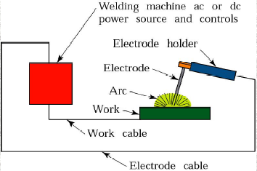
Arc Welding Equipments

Slide 6
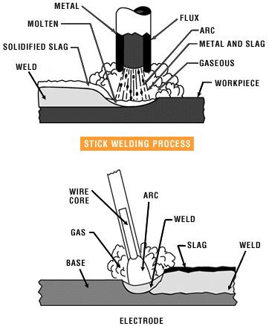
Metal arc welding

Slide 7
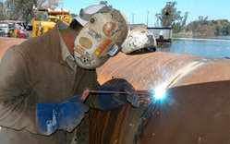
Arc Welding
Uses an electric arc to coalesce metals
Arc welding is the most common method of welding metals
Electricity travels from electrode to base metal to ground

Slide 8
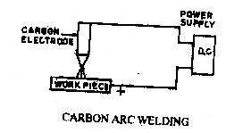
Carbon Arc Welding

Slide 9
Arc welding
Advantages
  Most efficient way to join metals
  Lowest-cost joining method
  Affords lighter weight through better utilization of materials
  Joins all commercial metals
  Provides design flexibility
Limitations
Manually applied, therefore high labor cost.
Need high energy causing danger
Not convenient for disassembly.
Defects are hard to detect at joints.

Slide 10
Comparison of A.C. and D.C. arc welding
Alternating Current (from Transformer)
More efficiency
Power consumption less
Cost of equipment is less
Higher voltage – hence not safe
Not suitable for welding non ferrous metals
Not preferred for welding thin sections
Any terminal can be connected to the work or electrode

Slide 11
Comparison of A.C. and D.C. arc welding
Direct Current (from Generator)
Less efficiency
Power consumption more
Cost of equipment is more
Low voltage – safer operation
suitable for both ferrous non ferrous metals
preferred for welding thin sections
Positive terminal connected to the work
Negative terminal connected to the electrode

Slide 12
GAS WELDING
Sound weld is obtained by selecting proper size of flame, filler material and method of moving torch
The temperature generated during the process is 3300⁰c
When the metal is fused, oxygen from the atmosphere and the torch combines with molten metal and forms oxides, results defective weld
Fluxes are added to the welded metal to remove oxides
Common fluxes used are made of sodium, potassium. Lithium and borax.
Flux can be applied as paste, powder,liquid.solid coating or gas.

Slide 13
GAS WELDING EQUIPMENT...
1. Gas Cylinders
Pressure
Oxygen – 125 kg/cm2
Acetylene – 16 kg/cm2
2. Regulators
Working pressure of oxygen 1 kg/cm2
Working pressure of acetylene 0.15 kg/cm2
Working pressure varies depends upon the thickness of the work pieces welded.
3. Pressure Gauges
4. Hoses
5. Welding torch
6. Check valve
7. Non return valve

Slide 14
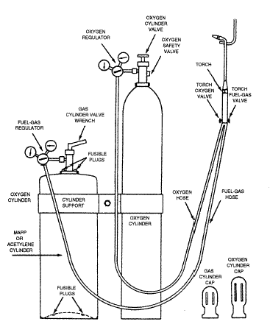
Oxy-Acetylene welding

Slide 15
TYPES OF FLAMES…
Oxygen is turned on, flame immediately changes into a long white inner area (Feather) surrounded by a transparent blue envelope is called Carburizing flame (3000⁰c)
Addition of little more oxygen give a bright whitish cone surrounded by the transparent blue envelope is called Neutral flame (It has a balance of fuel gas and oxygen) (3200⁰c)
Used for welding steels, aluminium, copper and cast iron
If more oxygen is added, the cone becomes darker and more pointed, while the envelope becomes shorter and more fierce is called Oxidizing flame
Has the highest temperature about 3400⁰c
Used for welding brass and brazing operation

Slide 16
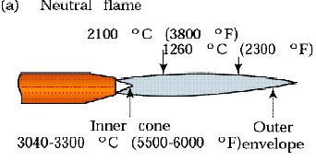
Three basic types of oxyacetylene flames used in oxyfuel-gas welding and cutting operations: (a) neutral flame; (b) oxidizing flame; (c) carburizing, or reducing flame.

Slide 17
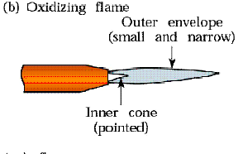
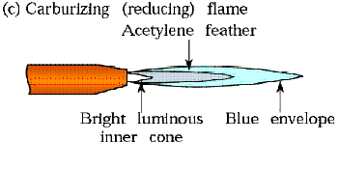
Three basic types of oxyacetylene flames used in oxyfuel-gas welding and cutting operations:
(a) neutral flame; (b) oxidizing flame; (c) carburizing, or reducing flame.

Slide 18
GAS CUTTING
Ferrous metal is heated in to red hot condition and a jet of pure oxygen is projected onto the surface, which rapidly oxidizes
Oxides having lower melting point than the metal, melt and are blown away by the force of the jet, to make a cut
Fast and efficient method of cutting steel to a high degree of accuracy
Torch is different from welding
Cutting torch has preheat orifice and one central orifice for oxygen jet
PIERCING and GOUGING are two important operations
Piercing, used to cut a hole at the centre of the plate or away from the edge of the plate
Gouging, to cut a groove into the steel surface

Slide 19
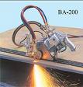
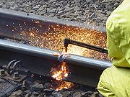
GAS CUTTING…
Automatic Gas Cutting
Manual Gas Cutting

Slide 20
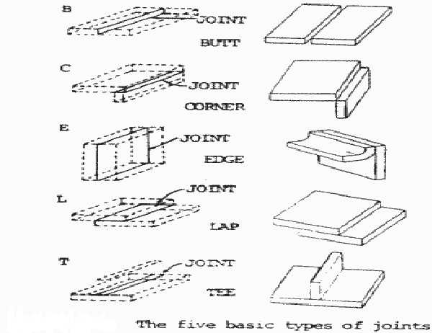
Weld joints

